Slide 1
Making a Mesh of the Infrastructure
Pete Brown
Network Engineer, AutoZone
@jpbrown1

Slide 2

Pete has supported various functional areas of infrastructure for around 20 years. He is a proponent of democratizing access to infrastructure data in order to promote learning, facilitate better decision making and reduce reliance on tribal knowledge.

Slide 3
Agenda
The Challenge
Infrastructure Sources
Traditional Approaches
Mesh Integration
Demo
Q&A

Slide 4
The Challenge
We are often asked to collect and analyze data from disparate infrastructure source types. These efforts are hindered by constant technological and environmental changes.
How can we mitigate the impact of these changes to reduce time spent on development and maintenance?

Slide 5
The SOLUTION
Apply data mesh* principles! Infrastructure data sources should be:
Discoverable
Addressable
Trustworthy
Self-Describing
Interoperable
Secure
https://martinfowler.com/articles/data-monolith-to-mesh.html

Slide 6
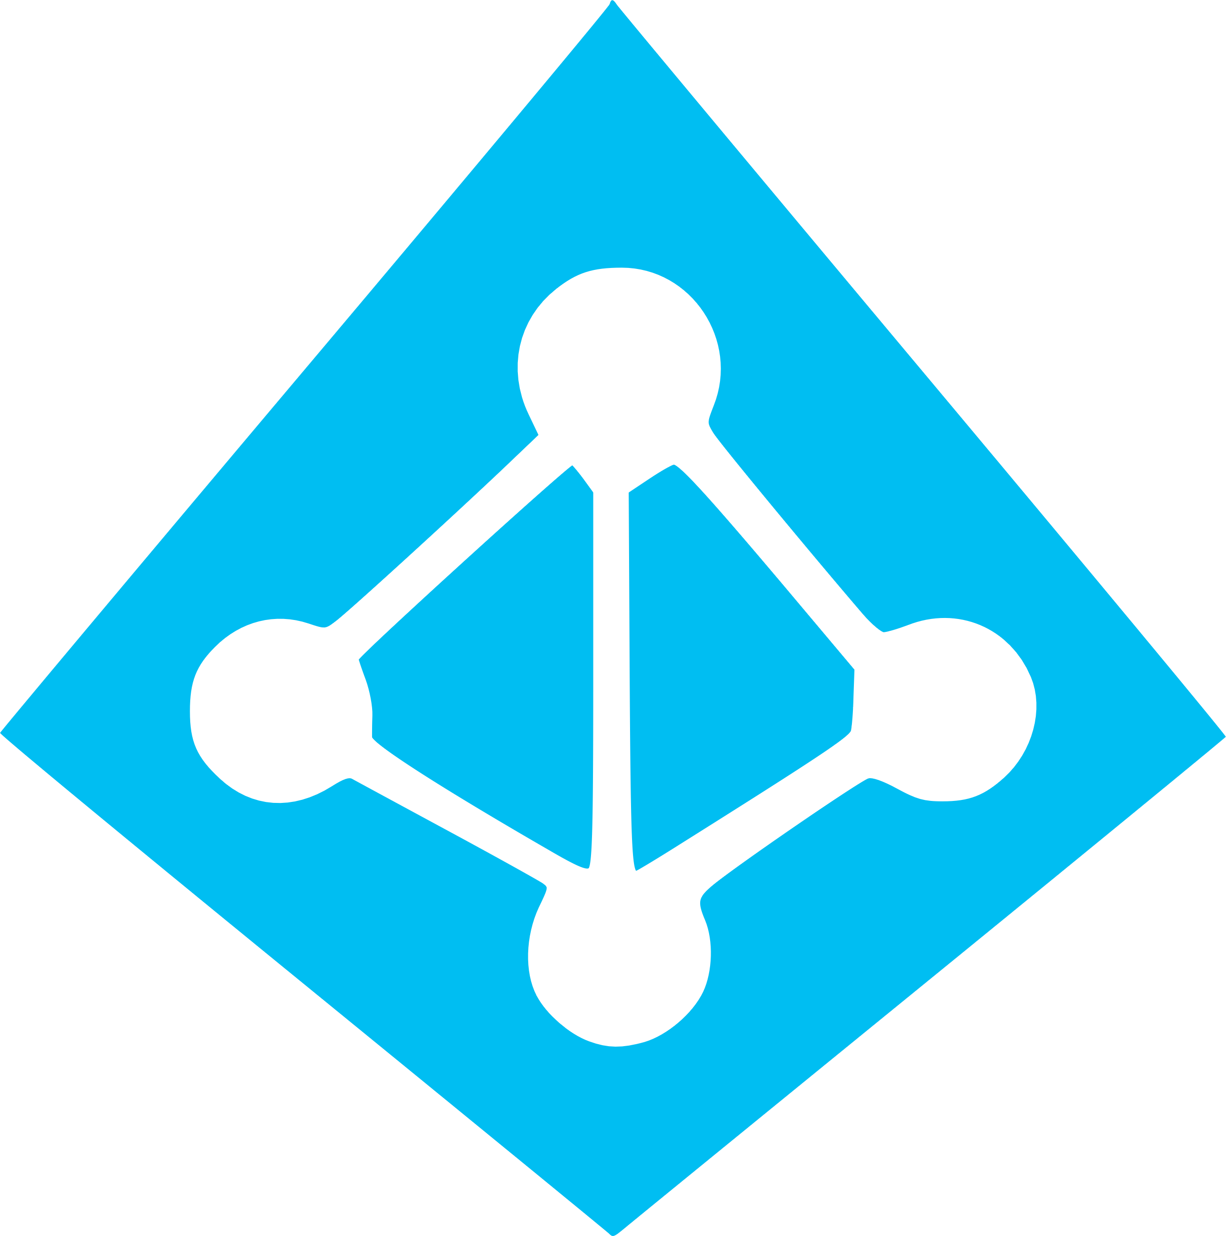










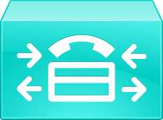



Common Infrastructure Sources
Directory Services
Network
InfoSec
Telephony

Slide 7

Common Infrastructure Sources
Directory Services
Hi! I need a list of Active Directory users.
Okay, here you go…

Slide 8

Common Infrastructure Sources
Directory Services

Slide 9

Accessing a Source – NO API
Active Directory
CUCM
(Your Python script)
NetScaler
Consumer
Native

Slide 10
Sample sources
Source Type | Protocol | Data Format | Spec Format | Spec Source | Client Language
Meraki | REST | XML/JSON | OpenAPI | Application | any
CUCM – AXL/RIS | SOAP | XML | PDF/HTML | Application | any
CUCM - JTAPI | JTAPI | binary | PDF/HTML | Application | Java
CUC - CUPI | REST | XML | PDF/HTML | Internet | any
NetScaler | REST | JSON | PDF/HTML | Internet | any
Active Directory | LDAP | binary | PDF/HTML | Internet | any

Slide 11
Accessing a Source – DIRECT API
1
2
3
4
5
Study Integration Interface(s)
Implement Interface Libraries
Discover Instances
Acquire Credentials & Roles
Address Routing & Firewall Issues
Could be an API or native protocol (SQL, LDAP, etc)
Acquire or create language specific interface libraries
What instances are running in the environment? What versions are they running?
Work with service owners to acquire credentials & roles for each instance
Work with network and security groups to resolve any communication issues

Slide 12
Accessing a Source – DIRECT API
Active Directory
CUCM
(Your Python script)
NetScaler
Consumer
Native

Slide 13
DRP – Declarative Resource Protocol
A JSON based WebSocket subprotocol for declaring and consuming resources
Provides a relatively easy way to create a service mesh for the infrastructure
Allows consumers to focus on data analysis functions by reducing time spent on discovery and connectivity
The Registry and Broker nodes are meant to run as part of the network (containers on core switches)

Slide 14
DRP – Declarative Resource Protocol
Sources are declared, not discovered
Sources use a common format for declarations
Consumers use a single logical endpoint to access all sources
Consumers use a standardized RPC & pub/sub mechanism to access all sources
Promotes an integrate once, use many approach

Slide 15
Accessing a Source - MESH
Active Directory
Web Client
CUCM
(Your Python script)
NetScaler
PowerShell
Registry
Provider
Logger
Broker
Consumer
Native

Slide 16
Accessing a Source - MESH
1
2
3
4
5
Study Integration Interface(s)
Implement Interface Libraries
Discover Instances
Acquire Credentials & Roles
Address Routing & Firewall Issues
Could be an API or native protocol (SQL, LDAP, etc)
Acquire or create language specific interface libraries
What instances are running in the environment? What versions are they running?
Work with service owners to acquire credentials & roles for each instance
Work with network and security groups to resolve any communication issues

Slide 17
Common Infrastructure Sources
X
Directory Services

Slide 18
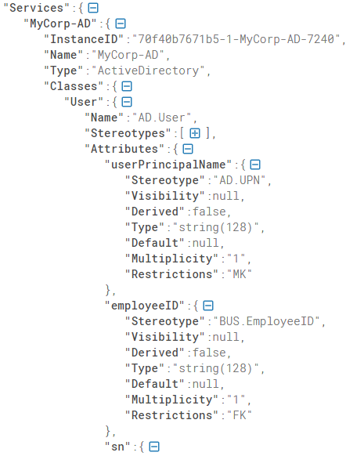
Common Infrastructure Sources
Directory Services

Slide 19
Common Infrastructure Sources
Directory Services
Network
DRP MESH
InfoSec
Telephony

Slide 20
Demo Time

Slide 21
DRP Mesh Components
Active Directory
Web Client
CUCM
(Your Python script)
NetScaler
PowerShell
Registry
Provider
Logger
Broker
Consumer
Native

Slide 22
DRP Mesh Components - FUTURE
DRP capable native services would not require shim providers
Active Directory
Web Client
CUCM
(Your Python script)
NetScaler
PowerShell
Registry
Provider
Logger
Broker
Consumer
Native

Slide 23
Is it for you?
Pros
Cons
Simplifies source access
Promotes integrate once, use many approach
Promotes learning
Allows the use of non-listening services
Can inject services into insecure zones
Potentially consolidates access to all aspects of an object
Reduces perception of “black boxes”
Can enhance HA/DR capabilities
Optional caching mechanism
May lead to using graph queries with disparate infrastructure sources
Loss of resolution in source system logs (single API user) for pre-existing sources
Elimination of shortest route between consumer and source
Dynamic nature of connections may cause confusion when troubleshooting
Small development team (1)

Slide 24
Q & A
Project used in demo:
https://github.com/adhdtech/DRP

